Slide 1
WEB REQUEST
Tenacious

Slide 2
Teammates
Aakaash M
Ajaybharathi K
Archana M
Aravinth S
Atsaya A
Jeevanantham N
Karthickraja S
Logesh Kumar K
Madujith M A
Vidhyapriya V
– aakaash.manimaran@aspiresystems.biz
– ajay.kesav@aspiresystems.biz
– archana.murug@aspiresys.biz
– aravinth.subraman@aspiresys.biz
– atsaya.arivunidhi@aspiresystems.biz
– jeevan.naga@aspiresys.biz
– karthick.selva@aspiresys.biz
– logesh.karthik@aspiresystems.biz
– madujith.ayyasamy@aspiresystems.biz
– vidhya.velmurugan@aspiresystems.biz

Slide 3
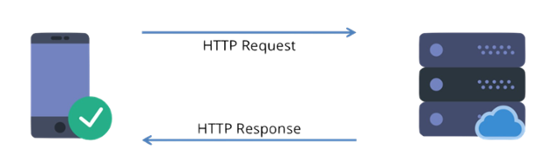
Web Request
A web request is a communicative message that is transmitted between the client, or web browsers, to the servers. This request is essential in providing the user with the correct and preferred webpages that the server will then display on the user's interface.
How do web requests work?
The browser sends an HTTP request message to the server, asking it to send a copy of the website to the client (you go to the shop and order your goods). This message, and all other data sent between the client and the server, is sent across your internet connection using TCP/IP.

Slide 4
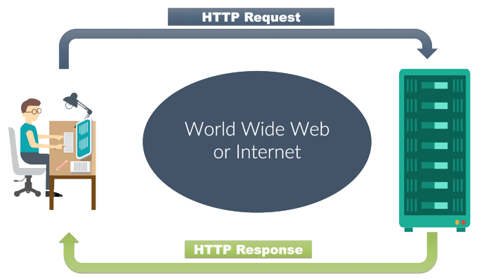
The Request and Response Cycle
It is important to be able to visualize the way information flows through the system; typically called the Request/Response Cycle.
HTTP Requests and Responses :
The HyperText Transfer Protocol gives us rules about how messages should be sent around the Internet. The system that initiates a connection sends a “request”, and the system the answers sends a “response”.
HTTP Request :
When a “client” (like a web browser) retrieves information, it sends a payload of data to a server as a “request”.

Slide 5
The HTTP Request Lifecycle
1.Local Processing
4.Send an HTTP Request
3.Establish a TCP Connection
2.Resolve an IP
5.Tearing Down and Cleaning Up

Slide 6
1. Local Processing : DNS Lookup: The client tries to resolve the domain name for the request.
Client sends DNS Query to local ISP DNS server
2. Resolve an IP : Your request will now have to travel many network devices to reach its target DNS server.Once your request arrives at your configured DNS server, the server looks for the address associated with the requested hostname. If it finds one, it sends a response. 3. Establish a TCP Connection : TCP ensures delivery and ordered data transmission. 4. Send an HTTP Request : Once the server receives the request, processes it, and finds the resource being requested, it generates an HTTP response. 5. Tearing Down and Cleaning Up : Once the response has been fully delivered, the client sends a FIN packet at the TCP level, to which the server responds with an ACK, and then generally sends a FIN of its own, which the client responds to with its own ACK signal.

Slide 7
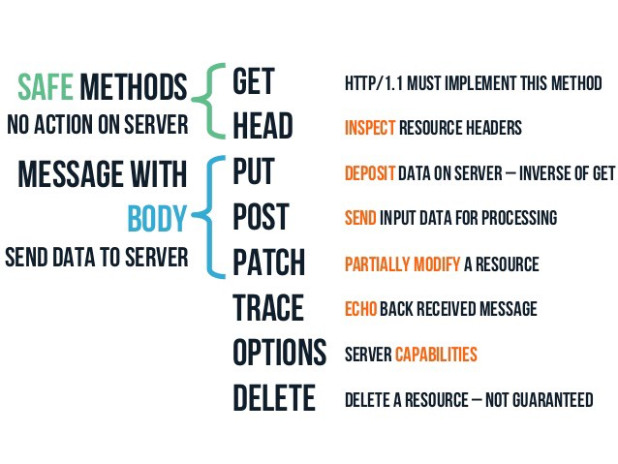
HTTP Request Methods :

